Slide 1


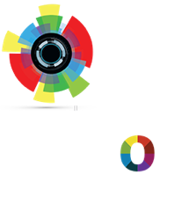

An Introduction to Machine Learning and How to Teach Machines to See
Facundo Parodi Tryolabs May 2019
© 2019 Tryolabs

Slide 2



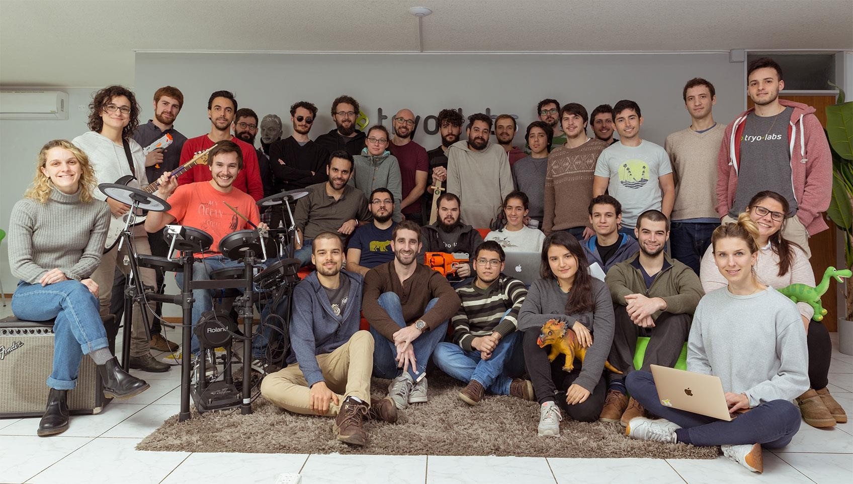
Who are we?
2

Slide 3
Outline
Machine Learning
Types of Machine Learning Problems
Steps to solve a Machine Learning Problem Deep Learning
Artificial Neural Networks Image Classification
Convolutional Neural Networks
2

Slide 4

What is a Cat?
© 2019 Tryolabs

Slide 5


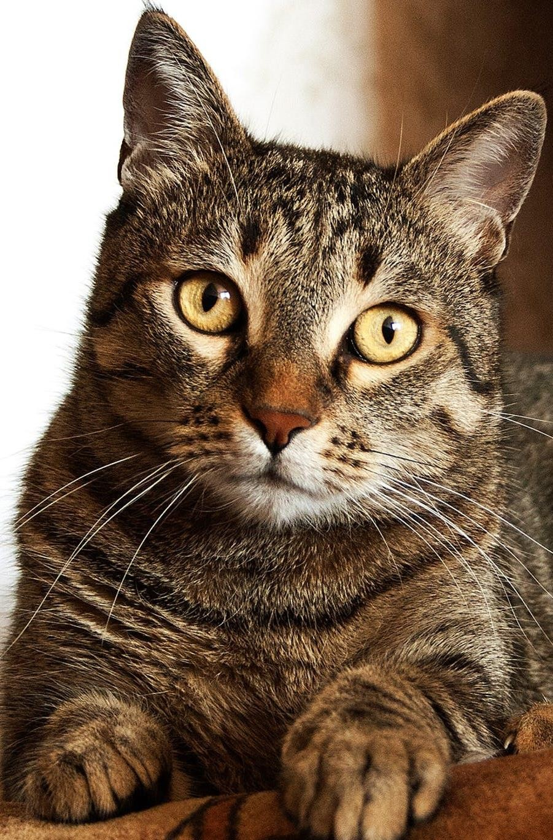
What is a Cat?
5

Slide 6




What is a Cat?
Occlusion
Diversity
Deformation
Lighting variations
5

Slide 7

Introduction to Machine Learning
© 2019 Tryolabs

Slide 8

What is Machine Learning?
Introduction to Machine Learning
The subfield of computer science that “gives computers the ability to learn
without being explicitly programmed”.
(Arthur Samuel, 1959)
A computer program is said to learn from experience E with respect to some class of tasks T and performance measure P if its performance at tasks in T, as measured by P, improves with experience E.”
(Tom Mitchell, 1997)
Using data for answering questions Training Predicting

Slide 9
The Big Data Era
Introduction to Machine Learning
Services
Cloud Computing:
Online storage
Infrastructure as a Service
User applications:
Data
Data already available everywhere
Low storage costs: everyone has several GBs for “free”
Hardware more powerful and cheaper than ever before
Devices
Everyone has a computer fully packed with sensors:
GPS
Cameras
Microphones
YouTube
Gmail
Facebook
Twitter
Permanently connected to Internet

Slide 10
Types of Machine Learning Problems
Introduction to Machine Learning
Supervised
Unsupervised
Reinforcement

Slide 11
Types of Machine Learning Problems
Introduction to Machine Learning
Learn through examples of which we know the desired output (what we want to predict).
Supervised
Is this a cat or a dog?
Are these emails spam or not?
Unsupervised
Predict the market value of houses, given the square meters, number of rooms, neighborhood, etc.
Reinforcement

Slide 12
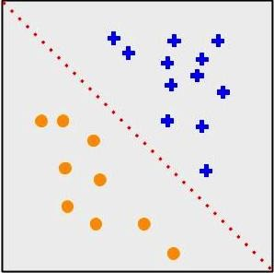
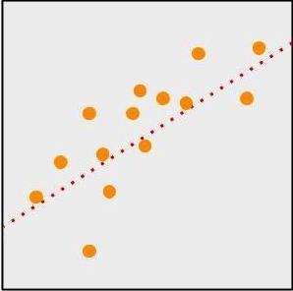
Types of Machine Learning Problems
Introduction to Machine Learning
Supervised
Classification
Output is a discrete variable (e.g., cat/dog)
Unsupervised
Regression
Output is continuous (e.g., price, temperature)
Reinforcement

Slide 13
Types of Machine Learning Problems
Introduction to Machine Learning
Supervised
There is no desired output. Learn something about the data. Latent relationships.
Unsupervised
I have photos and want to put them in 20 groups.
I want to find anomalies in the credit card usage patterns of my customers.
Reinforcement

Slide 14
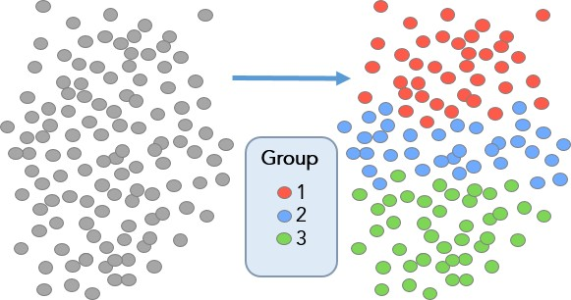
Types of Machine Learning Problems
Introduction to Machine Learning
Supervised
Useful for learning structure in the data (clustering), hidden correlations, reduce dimensionality, etc.
Unsupervised
Reinforcement

Slide 15
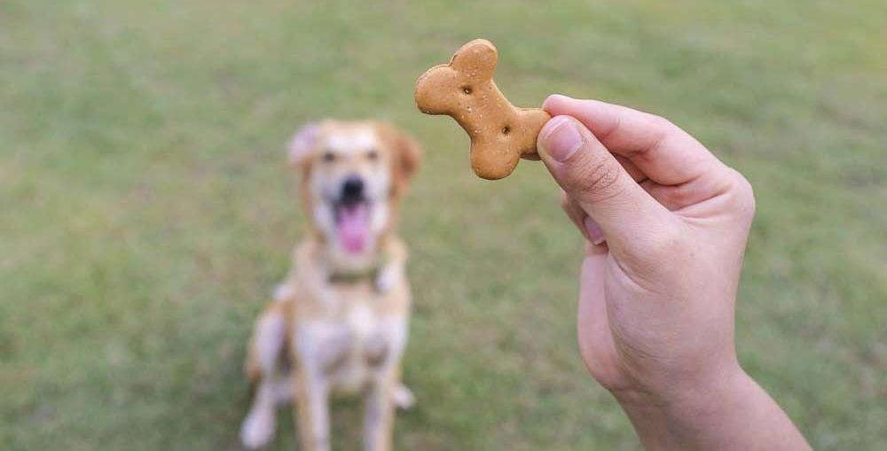
Types of Machine Learning Problems
Introduction to Machine Learning
Supervised
An agent interacts with an environment and watches the result of the interaction.
Environment gives feedback via a positive or negative reward signal.
Unsupervised
Reinforcement

Slide 16
Introduction to Machine Learning
Steps to Solve a Machine Learning Problem
Data Gathering
Collect data from various sources
Data Preprocessing
Clean data to have
homogeneity
Feature Engineering
Making your data more useful
Algorithm Selection
& Training
Selecting the right machine learning model
Making Predictions
Evaluate the model

Slide 17
Data Gathering
Introduction to Machine Learning
Might depend on human work
Manual labeling for supervised learning.
Domain knowledge. Maybe even experts.
May come for free, or “sort of”
E.g., Machine Translation.
The more the better: Some algorithms need large amounts of data to be useful (e.g., neural networks).
The quantity and quality of data dictate the model accuracy

Slide 18
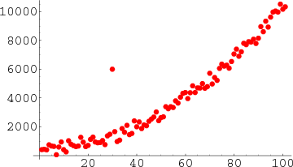
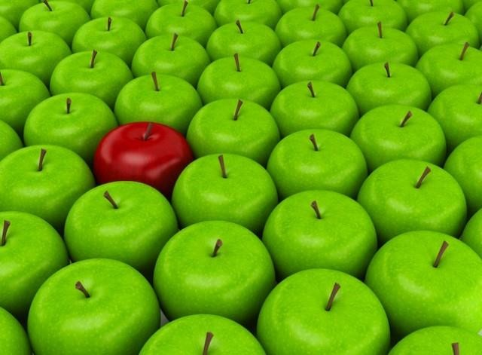
Data Preprocessing
Introduction to Machine Learning
Is there anything wrong with the data?
Missing values
Outliers
Bad encoding (for text)
Wrongly-labeled examples
Biased data
Do I have many more samples of one class than the rest?
Need to fix/remove data?

Slide 19
Feature Engineering
Introduction to Machine Learning
What is a feature?
A feature is an individual measurable property of a phenomenon being observed
Our inputs are represented by a set of features.
To classify spam email, features could be:
Number of words that have been ch4ng3d
like this.
Language of the email (0=English, 1=Spanish)
Number of emojis
Buy ch34p drugs from the ph4rm4cy now :) :) :)
Feature
engineering
(2, 0, 3)

Slide 20
Feature Engineering
Introduction to Machine Learning
Extract more information from existing data, not adding “new” data per-se
Making it more useful
With good features, most algorithms can learn faster It can be an art
Requires thought and knowledge of the data Two steps:
Variable transformation (e.g., dates into weekdays, normalizing)
Feature creation (e.g., n-grams for texts, if word is capitalized to detect names, etc.)

Slide 21
Algorithm Selection & Training
Introduction to Machine Learning
Supervised
Unsupervised
Linear classifier
Naive Bayes
Support Vector Machines (SVM)
Decision Tree
Random Forests
k-Nearest Neighbors
Neural Networks (Deep learning)
PCA
t-SNE
k-means
DBSCAN
Reinforcement
SARSA–λ
Q-Learning

Slide 22




Algorithm Selection & Training
Introduction to Machine Learning
Goal of training: making the correct prediction as often as possible
Incremental improvement:
Predict
Adjust
Use of metrics for evaluating performance and comparing solutions
Hyperparameter tuning: more an art than a science

Slide 23















Making Predictions
Introduction to Machine Learning
Training Phase
Labels
Machine Learning model
Feature extraction
Samples
Features
Prediction Phase
Input
Feature extraction
Features
Trained classifier
Label

Slide 24
Summary
Introduction to Machine Learning
Machine Learning is intelligent use of data to answer questions
Enabled by an exponential increase in computing power and data availability
Three big types of problems: supervised, unsupervised, reinforcement
5 steps to every machine learning solution:
Data Gathering
Data Preprocessing
Feature Engineering
Algorithm Selection & Training
Making Predictions

Slide 25
Deep Learning
“Any sufficiently advanced technology is indistinguishable from magic.” (Arthur C. Clarke)
© 2019 Tryolabs

Slide 26
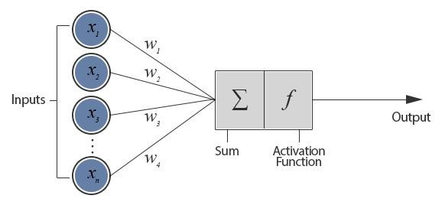
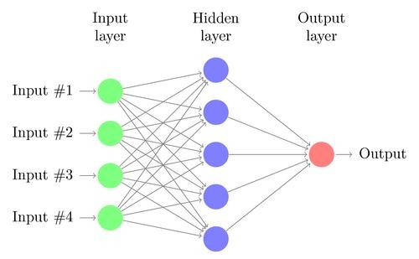
Artificial Neural Networks
Deep Learning
First model of artificial neural networks proposed in 1943
Analogy to the human brain greatly exaggerated
Given some inputs (𝑥), the network calculates some outputs (𝑦), using a set of weights (𝑤)
Perceptron (Rosenblatt, 1957)
Two-layer Fully Connected Neural Network

Slide 27
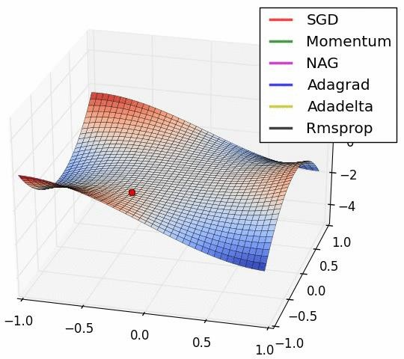
Loss function
Deep Learning
Weights must be adjusted (learned from the data)
Idea: define a function that tells us how “close” the network is to generating the desired output
Minimize the loss ➔ optimization problem
With a continuous and differentiable loss
function, we can apply gradient descent

Slide 28
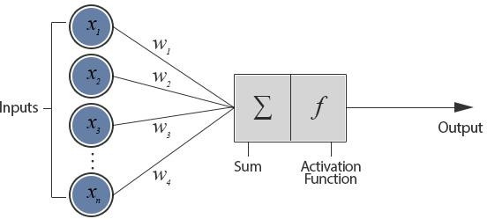
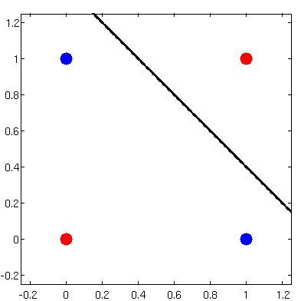

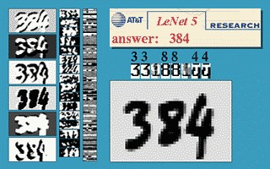

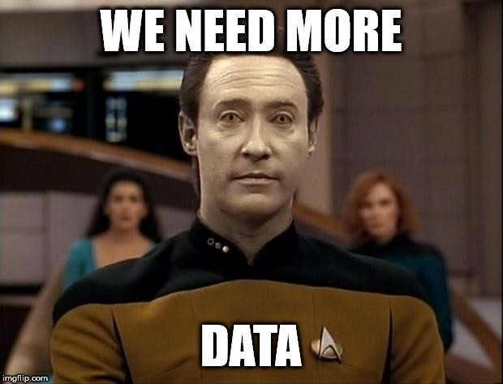
The Rise, Fall, Rise, Fall and Rise of Neural Networks
Deep Learning
Perceptron gained popularity in the 60s
Belief that would lead to true AI
XOR problem and AI Winter (1969 – 1986)
Backpropagation to the rescue! (1986)
Training of multilayer neural nets
LeNet-5 (Yann LeCun et al., 1998)
Unable to scale. Lack of good data and
processing power

Slide 29
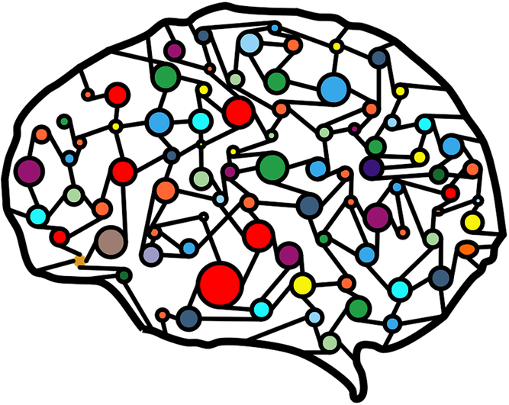
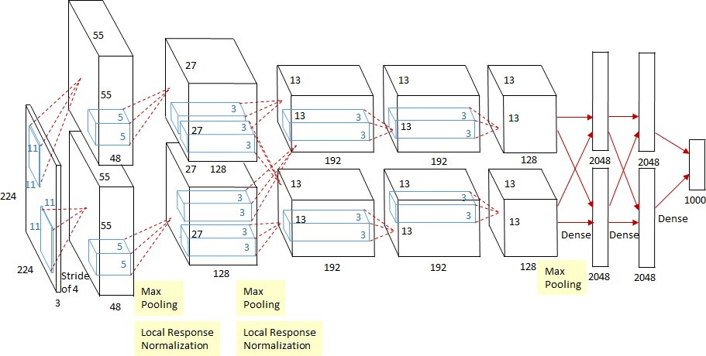
The Rise, Fall, Rise, Fall and Rise of Neural Networks
Deep Learning
Regained popularity since ~2006.
Train each layer at a time
Rebranded field as Deep Learning
Old ideas rediscovered (e.g., Convolution)
Breakthrough in 2012 with AlexNet (Krizhevsky et al.)
Use of GPUs
Convolution

Slide 30
Image Classification with Deep Neural Networks
© 2019 Tryolabs

Slide 31
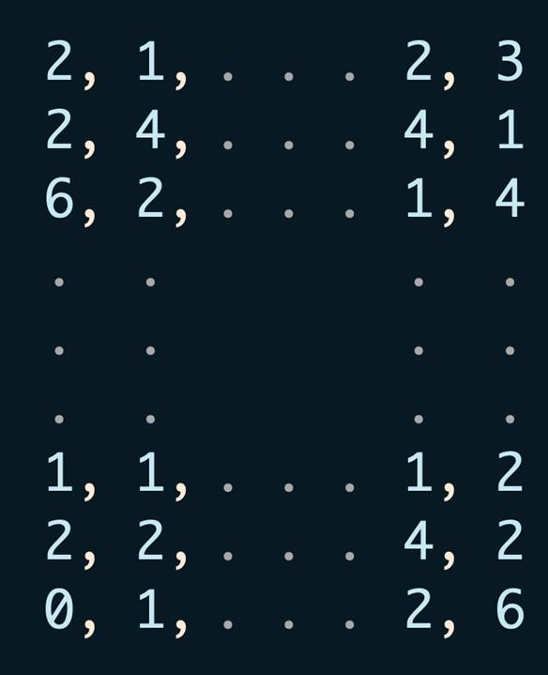
Digital Representation of Images
Image Classification with Deep Neural Networks
=
31

Slide 32
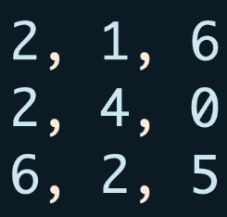
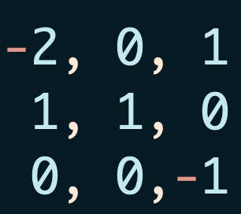
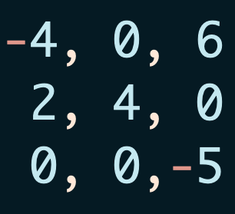

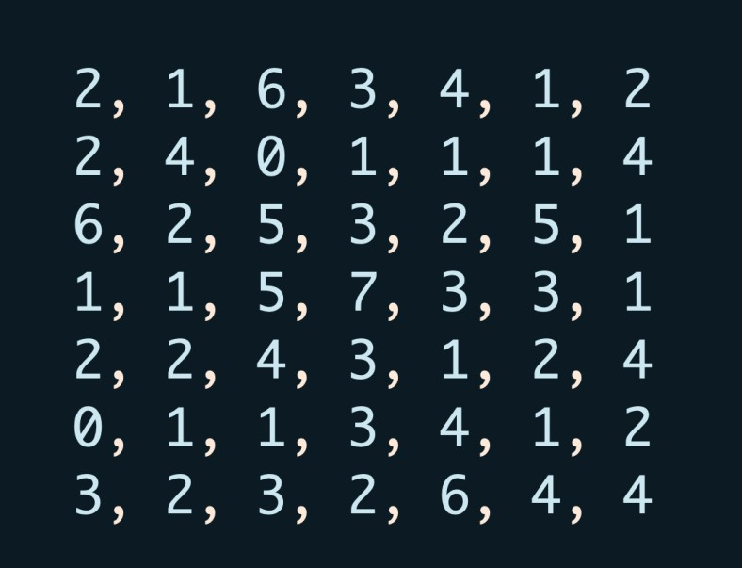

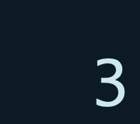
Image Classification with Deep Neural Networks
The Convolution Operator
∑
⊙
=
Kernel
Input
Output
31

Slide 33
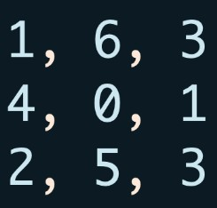
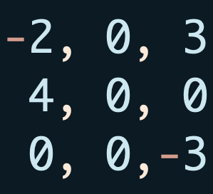

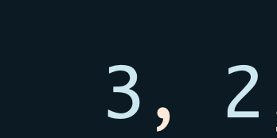
Image Classification with Deep Neural Networks
The Convolution Operator
∑
⊙
=
Kernel
Input
Output
31

Slide 34
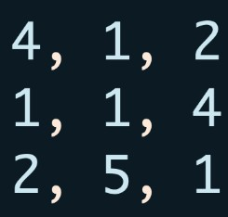
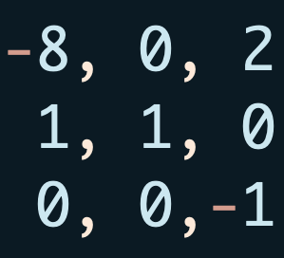

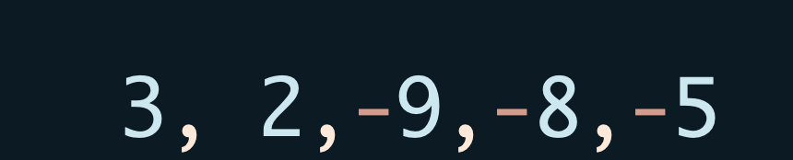
Image Classification with Deep Neural Networks
The Convolution Operator
∑
⊙
=
Kernel
Input
Output
31

Slide 35
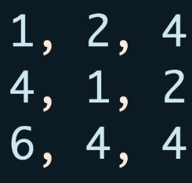
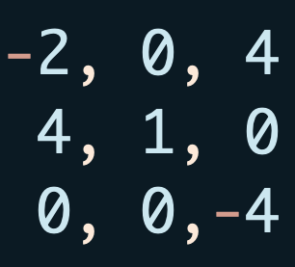

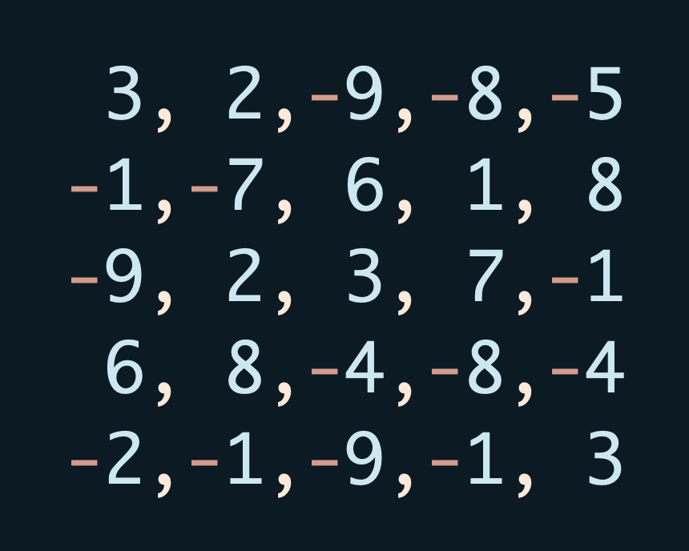
Image Classification with Deep Neural Networks
The Convolution Operator
∑
⊙
=
Kernel
Input
Output
31

Slide 36
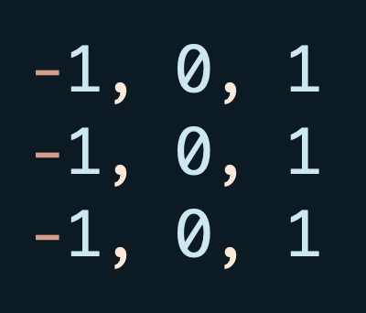
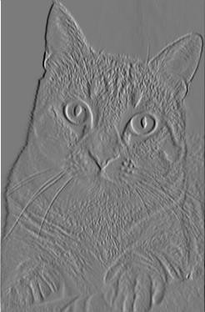

The Convolution Operation
Image Classification with Deep Neural Networks
Kernel
Input
Feature Map
31

Slide 37

Image Classification with Deep Neural Networks
The Convolution Operation
31

Slide 38











The Convolution Operation
Image Classification with Deep Neural Networks
Takes spatial dependencies into account
Used as a feature extraction tool
Differentiable operation ➔ the kernels can be learned
Traditional ML
Input
Feature extraction
Features
Trained classifier
Output
Deep Learning
Input
Trained
classifier
Output
31

Slide 39
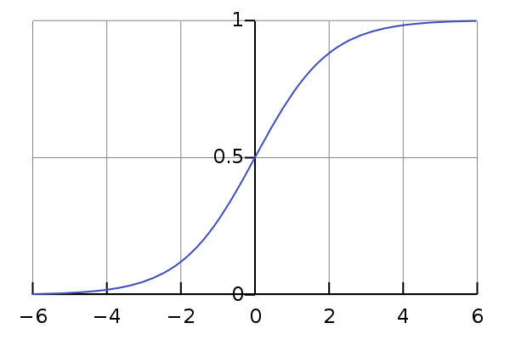
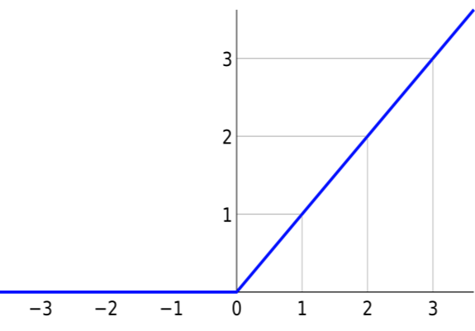
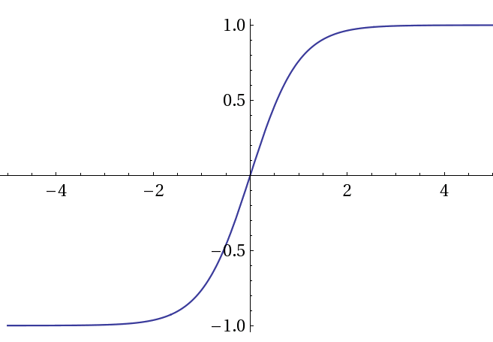
Non-linear Activation Functions
Image Classification with Deep Neural Networks
Increment the network’s capacity
Convolution, matrix multiplication and summation are linear
Sigmoid
1
Hyperbolic tangent
_{𝑒}2𝑥−1
ReLU
𝑓 𝑥 = max(0, 𝑥)
𝑓 𝑥 =
𝑡𝑎𝑛ℎ 𝑥 =
_{𝑒}2𝑥+1
1 + 𝑒^{−𝑥}
31

Slide 40
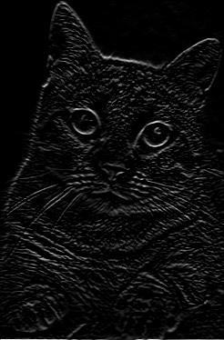
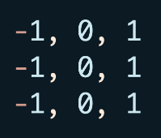
Image Classification with Deep Neural Networks
Non-linear Activation Functions
ReLU
31

Slide 41
The Pooling Operation
Image Classification with Deep Neural Networks
12 | 20 | 30 | 0
8 | 12 | 2 | 0
34 | 70 | 37 | 4
112 | 100 | 25 | 12
20 | 30
112 | 37
2x2 Max Pooling
Used to reduce dimensionality
Most common: Max pooling
Makes the network invariant to small transformations, distortions and translations.
31

Slide 42

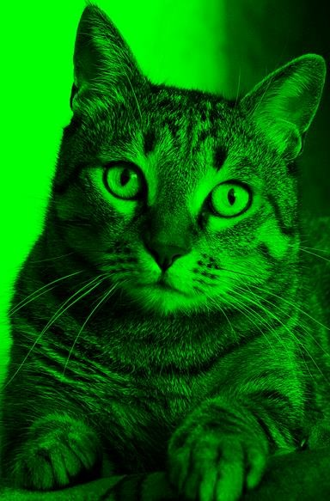

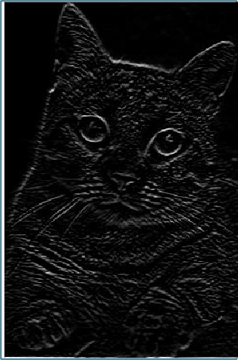
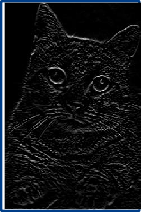
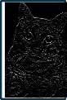


Putting all together
Image Classification with Deep Neural Networks
Input
Conv Layer
Non-Linear Function
Fully Connected Layers
Pooling
Conv Layer
Non-Linear Function
…
Pooling
Conv Layer
Non-Linear Function
Flatten
Feature extraction
Classification
31

Slide 43

Training Convolutional Neural Networks
Image Classification with Deep Neural Networks
Image classification is a supervised problem
Gather images and label them with desired output
Train the network with backpropagation!
Convolutional Network
Prediction: Dog
Loss
Function
Label: Cat
31

Slide 44

Training Convolutional Neural Networks
Image Classification with Deep Neural Networks
Image classification is a supervised problem
Gather images and label them with desired output
Train the network with backpropagation!
Convolutional Network
Prediction: Cat
Loss
Function
Label: Cat
31

Slide 45
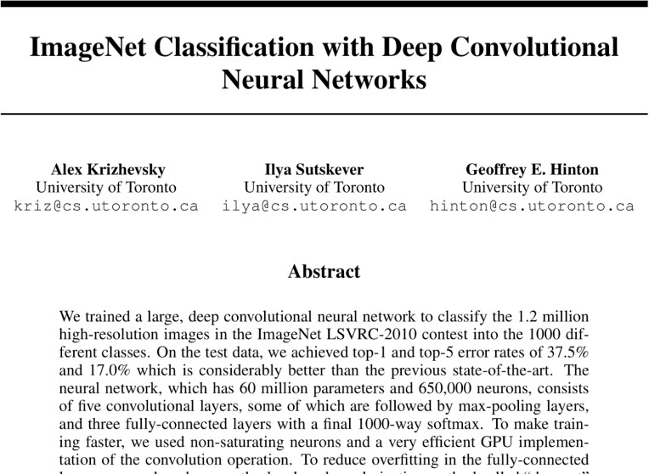
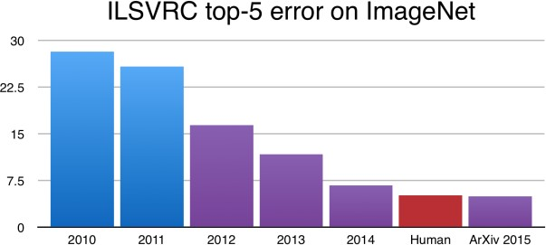
Image Classification with Deep Neural Networks
Surpassing Human Performance
31

Slide 46

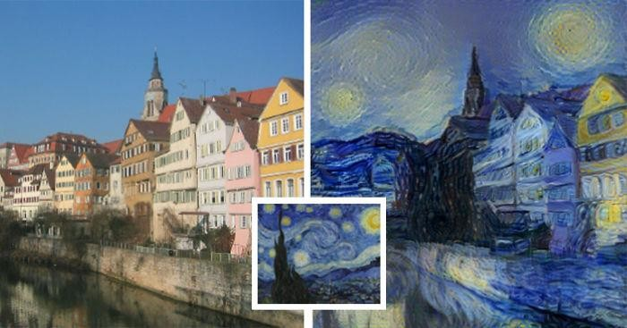

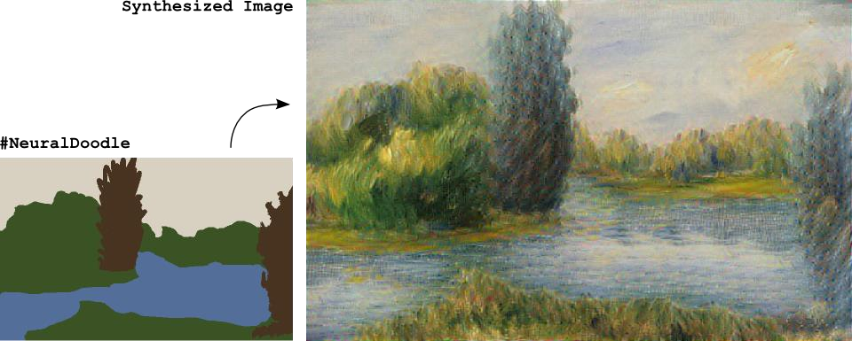
Deep Learning in the Wild
31

Slide 47

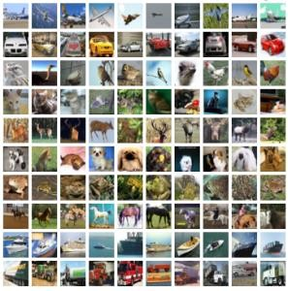
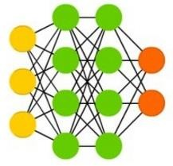















Deep Learning is Here to Stay
Data
Architectures
Frameworks
Power
Players
31

Slide 48
Conclusions
Machine learning algorithms learn from data to find hidden relations, to
make predictions, to interact with the world, …
A machine learning algorithm is as good as its input data
Good model + Bad data = Bad Results
Deep learning is making significant breakthroughs in: speech recognition,
language processing, computer vision, control systems, …
If you are not using or considering using Deep Learning to understand or
solve vision problems, you almost certainly should be
31

Slide 49
Resource
Our work
Tryolabs Blog https://www.tryolabs.com/blog
Luminoth (Computer Vision Toolkit) https://www.luminoth.ai
To Learn More…
Google Machine Learning Crash Course https://developers.google.com/machine- learning/crash-course/
Stanford course CS229: Machine Learning https://developers.google.com/machine- learning/crash-course/
Stanford course CS231n: Convolutional Neural Networks for Visual Recognition http://cs231n.stanford.edu/
31

Slide 50
Thank you!
© 2019 Tryolabs

